Slide 1
Easily Estimate Projects Using
Statistical PERT
William W. Davis
NCCI Holdings, Inc.

Slide 2

Your Learning Objectives
Refresh your memory on statistical terminology such as mean, median, mode, the normal probability curve, and standard deviation
Contrast deterministic estimates (predicting) from probabilistic estimates (forecasting)
Understand the five steps of Statistical PERT
Know the two key benefits of probabilistic estimation
Notes:
Self-explanatory.

Slide 3
Agenda
What’s your color energy?
Why do we estimate anything?
Estimation activity
3 types of estimates
Introduce Statistical PERT
The Five Steps of Statistical PERT
Statistical PERT exercise
Statistical PERT demo and templates
Your next step
Notes:
Self-explanatory.

Slide 4
What Is Your
COLOR
Energy?
Notes:
Explain that each of us has four “color energies”: blue, red, green, yellow, and that one color dominates. This is just a way for me to get a “read” about my audience, so I can give more details if there are lots of “blue” energy folks, and I speed over details if I have a lot of “red” energy folks. It also helps me to build rapport with the audience.

Slide 5
What Is Your Color Energy?
Give Me the Details
Be Brief,
Be Bright,
Be Gone
Show Me
You Care
Involve Me
Source: http://www.insights.com/
Notes:
I walk through the four color energies, and at the end, I ask each person to self-identify with their own most dominant color energy.

Slide 6

Why Do We Estimate Anything?
Why Do I Estimate?
Notes:
This is a probing question. I’ll ask the audience to answer this question, and then I’ll share with them my own answer.

Slide 7

Why Do We Estimate Anything?
To align everyone’s expectations about uncertainties
Notes:
Reason #1: we estimate to get alignment between two or more people. Before we agree about something, we have to align.

Slide 8

Why Do We Estimate Anything?
To make better, more informed decisions
Notes:
Reason #2: Once we’re aligned, we can make better, more informed decisions: about whether we should proceed with a project, about how many resources the project needs, about the risk of the project going over budget or finishing late.

Slide 9

Why I Use Statistical PERT
To align everyone’s expectations about project uncertainties
To make better,
more informed project decisions
Notes:
I’ll share one or more personal anecdotes: about arriving at a restaurant and being told that the wait time was 1 hour, 20 minutes. What was that estimate? The mean? The mode? P99? Something else?
My PMO director asked her PMs for their “best estimate” about project cost during the budget season. What is that? The expected value? The most probable cost? The maximum possible cost?
I interviewed fellow PMs: At what confidence level do you estimate your project tasks? Answer: 50 – 100%! Everyone was different! How will sponsors make good decisions in the face of such uncertainty?
This is a KEY SLIDE for the presentation. The reason anyone should consider using ANY estimation technique – whether Statistical PERT, Monte Carlo simulation, or any other tool or technique – is to GET ALIGNED about the nature of uncertainty and to MAKE BETTER DECISIONS using better information about that uncertain nature.

Slide 10
Estimation
Activity
Notes:
Transition slide.

Slide 11

Estimation Activity
How
OLD
am I?
Notes:
This is to re-energize the room. Everyone can call out my age. I look for the average age, the mode.
How well does deterministic estimation work for a restaurant or bar serving alcohol, or a grocer selling alcohol?
Then, I ask for 3-point estimates of my age. What is the youngest age I could reasonable be? How about my oldest reasonable age? But 3-point estimates don’t convey the relative confidence about the mode.

Slide 12

Three Types of Estimates
Deterministic
Three-Point
Probabilistic
Notes:
Recap the first two types of estimates: deterministic (single-value) and 3-point, and introduce stochastic (probabilistic) estimate concept.

Slide 13

Deterministic Estimates
Single number
Meaning unclear
Conveys no sense of likelihood
Notes:
Recap deterministic estimates. Single values don’t convey much insight. How sure is the estimator about the single value? How much risk is present?

Slide 14

Three Point Estimation
Minimum
Most Likely
Maximum
Little sense of relative likelihood
Notes:
Three-point estimates are better for assessing risk. But still the question remains, how likely is the most likely outcome?

Slide 15
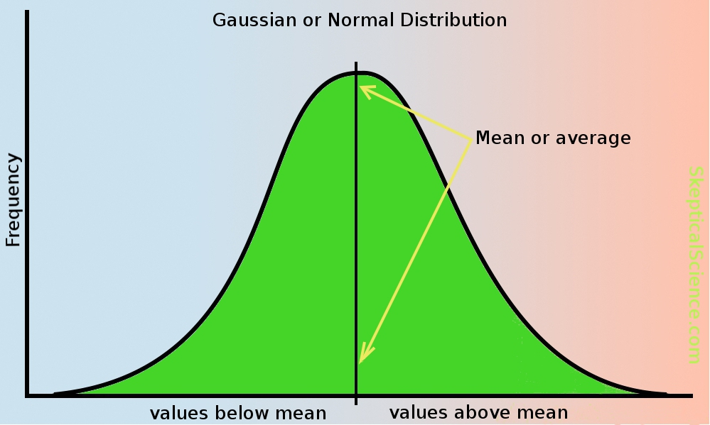
Probabilistic (Stochastic) Estimation
Notes:
Introduce the bell-shaped curve. Y-axis is frequency, X-axis is the value of an uncertainty (time, cost, whatever).
Point out where the sum guesses of my age estimates would appear on a bell-shaped curve.
Point out where the mean, median and mode are, and that standard deviation is a relative measure of how dispersed are the uncertainty’s values.

Slide 16
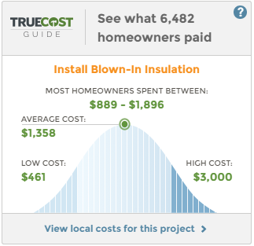
Probabilistic Estimates Are Everywhere
Notes:
Point out that bell-shaped curves appear everywhere in life. Here, HomeAdvisor shows me the variation in cost of insulating my attic.

Slide 17
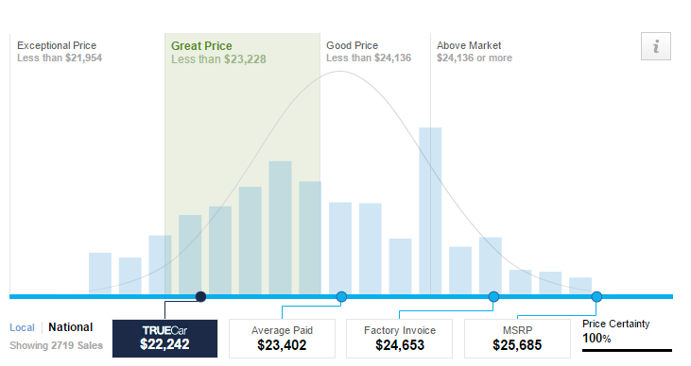
Probabilistic Estimates Are Everywhere
Notes:
Here, TrueCar uses a bell-shaped curve to show the variation in a car’s selling price. Notice the imperfect appearance – bell-curves are rarely perfectly shaped, but still useful even though they may be skewed or have odd peaks.

Slide 18
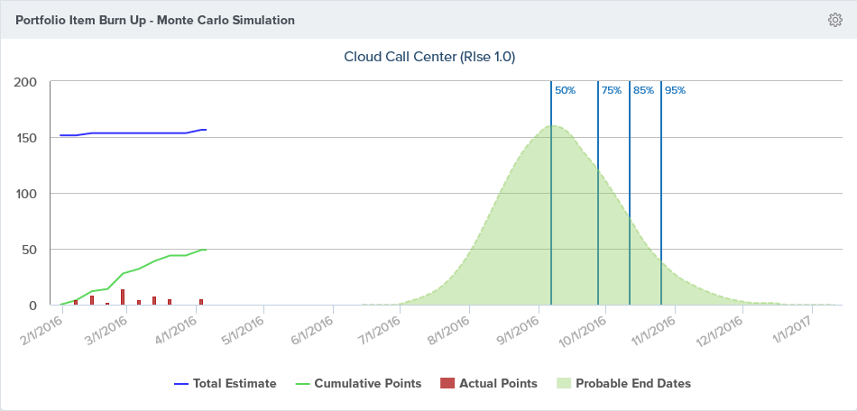
Probabilistic Estimates Are Everywhere
Notes:
Here, agile software maker VersionOne uses Monte Carlo simulation and the Central Limit Theorem to create a bell-shaped curve of possible finish dates for an agile project.

Slide 19

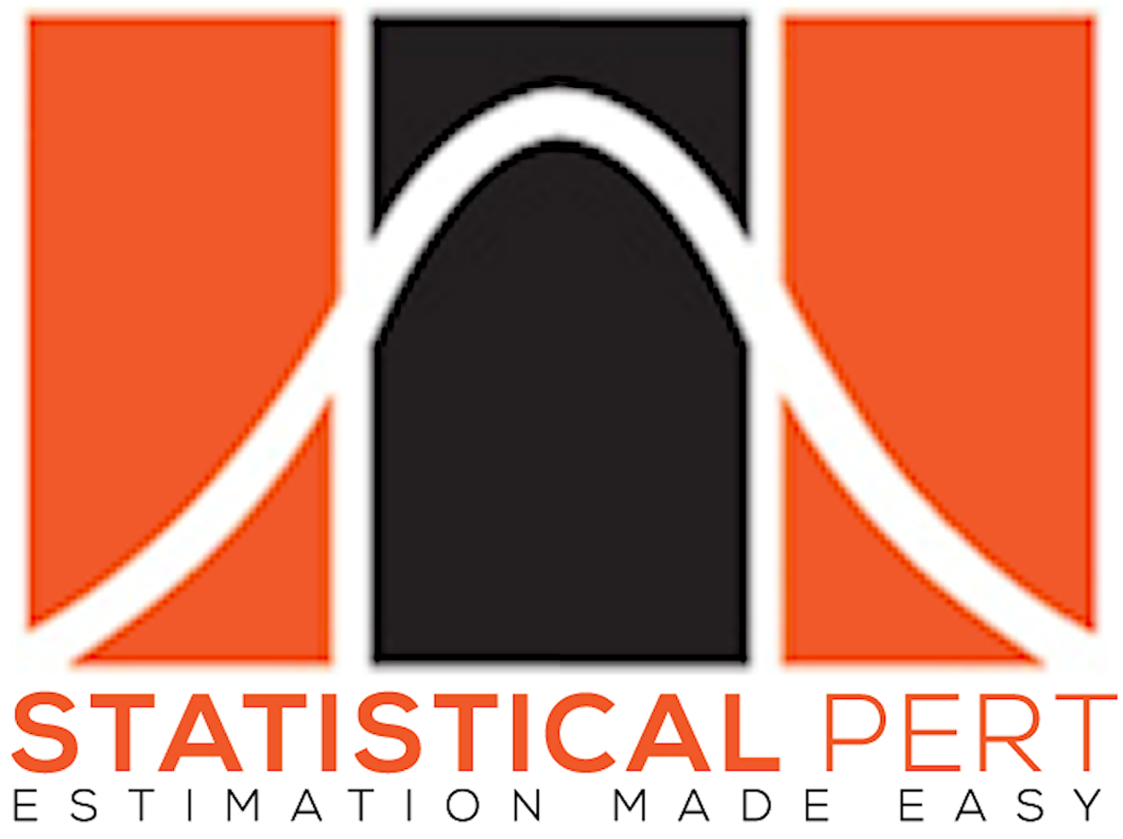
Introducing
Notes:
New section.

Slide 20

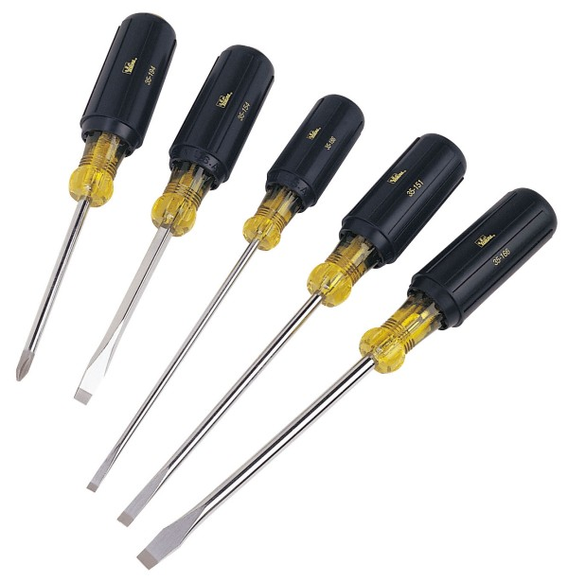
The Project Manager’s Toolbox
Notes:
I may use object lessons for this part of the presentation, to re-focus everyone’s attention. The slide above shows builder’s tools which are metaphors for the tools that a project manager uses.

Slide 21

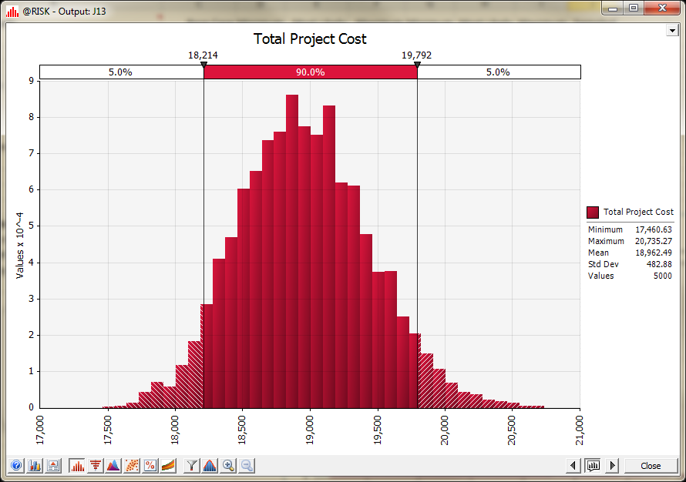


The Project Manager’s Toolbox
Notes:
Statistical PERT is like a simple screwdriver – it solves a not-so-complex problem, quickly and easily. Monte Carlo simulation software, like Palisade’s @Risk7, solves very complex problems, but that takes a lot of time, skill and effort to construct a simulation model. That level of effort is sometimes warranted, but sometimes it’s not. And every large project begins with very high-level estimates that are supposed to be quick enough to be timely, but accurate enough to help decision-makers understand the nature of the uncertainty upon which they are making one or more decisions.

Slide 22
The PM’s Dilemma
Estimation Accuracy
Cost
Notes:
There is a tension between quick-and-easy and accuracy. The PM’s dilemma is to strike the right balance between the cost of creating an estimate and the accuracy obtained from that cost.

Slide 23

Greater Estimation Accuracy = Greater Cost
Estimate Accuracy
Cost
Notes:
When running a Monte Carlo simulation, it takes a lot of effort and skill to create a simulation model. The benefit is higher accuracy in estimating project cost and schedule. The drawback is the cost and effort it takes to construct and run the simulation model.

Slide 24
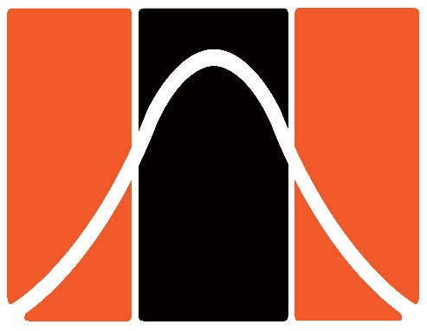

Lesser Estimation Accuracy = Lesser Cost
Estimate Accuracy
Cost
Notes:
Statistical PERT is a simple, probabilistic technique that works to solve no-cost or low-cost estimation problems that have reasonable accuracy under certain scenarios (variable independence, bell-shaped uncertainties). When you need this level of accuracy, creating a Monte Carlo simulation is not worth the cost or effort. Deterministic estimates, which are commonplace, don’t provide insight into the nature of the uncertainties being estimated. Statistical PERT goes beyond deterministic estimation but stops before Monte Carlo simulation.

Slide 25
Statistical PERT Pros & Cons
Pros:
Easy and quick to use
Allows for probabilistic estimation
No special software (just uses Excel)
Incorporates subjective opinion
Fully customizable
Adapts to different kinds of uncertainties
Integrates with Microsoft Project, Primavera
FREE!
Notes:
Self-explanatory. The customization benefit is explained later in the presentation.

Slide 26
Statistical PERT Pros & Cons
Cons:
Limited accuracy
  compared to Monte Carlo simulation
Limited to bell-shaped uncertainties
Assumes independent variables
Relies on the normal distribution
Depends on the estimator’s skill
Takes longer than deterministic estimates
Notes:
Self-explanatory.

Slide 27
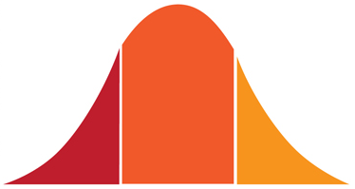

Statistical PERT Requirements
A bell-shaped uncertainty
Microsoft Excel®
2010 / 2013 / 2016
NORM.DIST function
NORM.INV function
Notes:
Self-explanatory. Statistical PERT concepts work with older versions of Excel, too, but the free Excel templates were introduced with Microsoft Excel 2010.

Slide 28

Statistical PERT Terminology
Mean is the arithmetic average
Median is the probabilistic midpoint
Mode is the most likely occurrence
The normal distribution (normal curve, bell-shaped curve, Gaussian distribution)
Standard deviation (helpful, not essential) is a measure of variation
Cumulative probability (the area under the curve starting from the left-side tail)
Notes:
These concepts were introduced earlier when I first introduced the bell-shaped curve. For anyone not paying attention at that point ☺ this is a recap of the statistical terms used throughout this presentation (except median, which is explained briefly but not used thereafter).

Slide 29
The Five Easy Steps of
Notes:
New Section. This section appeals to “blue” color energy folks, but not so much to “red” energy folks.

Slide 30
The Five Easy Steps of Statistical PERT
Create a 3-point estimate
Estimate the mean
Render a subjective opinion
about the mode
Create a SPERT standard deviation
Choose a planning estimate
Notes:
Self-explanatory. Each step is explained in the following slides. The color blue is intentional – blue energy people want to know what each step of the process entails.

Slide 31
The Five Easy Steps of Statistical PERT
Create a 3-point estimate
Estimate the mean
Render a subjective opinion
about the mode
Create a SPERT standard deviation
Choose a planning estimate
Notes:
Red energy folks don’t care as much for details (Be Brief, Be Bright, Be Gone). Using a freely licensed SPERT Excel template, the five steps are reduced to three steps (#1, #3, #5). The templates make the technique very easy and quick, but using a template isn’t necessary; a blank Excel spreadsheet will work, too.

Slide 32
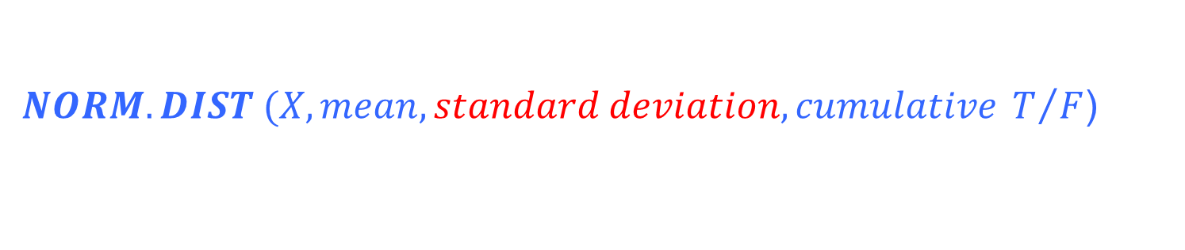
NORM.DIST and NORM.INV Excel functions
$NORM.DIST (X, mean, standard deviation, cumulative T/F$)
NORM.DIST requires four arguments:
X (any point along the x-axis)
mean (the arithmetic average, also known as the expected value)
standard deviation (for the implied normal curve)
TRUE/FALSE Boolean to indicate whether the result should be a cumulative probability or not. For our purposes, we will always specify TRUE.
Notes:
I’ll briefly show the arguments for the two, built-in, statistical functions for the normal curve: NORM.DIST and NORM.INV. Here, NORM.DIST is explained. Note the standard deviation in red: this is the nut that Statistical PERT seeks to crack – how to create a standard deviation for an uncertainty that involves the estimator’s subjective opinion (private knowledge, gut instinct, intuition).

Slide 33
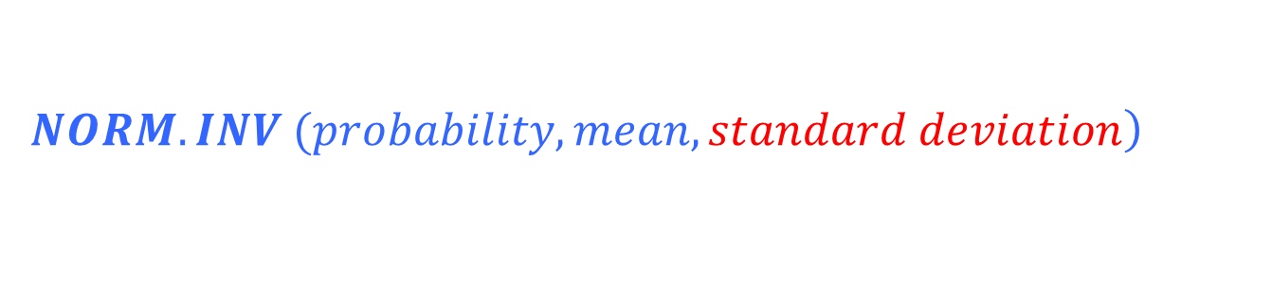
NORM.DIST and NORM.INV Excel functions
$$\left.NORM.INV (probability, mean, standard deviation\right)$$
NORM.INV requires three arguments:
probability = the cumulative probability of some value of X on the x-axis
mean (the arithmetic average, also known as the expected value)
standard deviation (for the implied normal curve).
Notes:
NORM.INV function explained, briefly. Again, standard deviation is required to use the function.

Slide 34
Step One – Create a Three Point Estimate
Notes:
Self-explanatory. Three point estimates are familiar to most PMs.

Slide 35
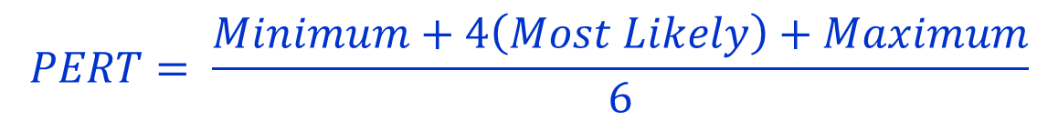
Step Two – Estimate the Mean
Estimate the mean using the PERT formula:
$$PERT= \frac{Minimum+4\left(Most Likely\right)+Maximum}{6}$$
Note: If the uncertainty is perfectly bell-shaped, the mean would be equal to the mode (most likely outcome) and median; however, most uncertainties are skewed, either to the left or to the right. So, in most instances, the mean will be different than the mode and median.
Notes:
Self-explanatory. PMPs had to study the PERT formula to prepare for the PMP exam. Statistical PERT uses the PERT formula to estimate the mean for an uncertainty. We don’t know what the true mean is because a single, estimated project task will be executed once. Projects are executed once, then closed. We estimate the mean (aka expected value) in the absence of data.

Slide 36
Step Three – Render a Subjective Judgment
How confident are you in your most likely outcome?
Nearly certain
High confidence
Medium-high confidence
Medium-low confidence
Low confidence
Guesstimate
Notes:
Green energy people (“Show me that you care”) and yellow energy people (“Involve me”) both get something out of Step Three. Estimation is more than just number-crunching, it’s about involving people’s intellect, emotions, intuitions and private knowledge. In Steps 3 and 4, estimators get to shape the normal curve so it better-fits the risk nature of an uncertainty.

Slide 37

Step Three – Render a Subjective Judgment
Notes:
This slide will re-focus the attention of the audience. We’re going to talk a little about gambling using a roulette wheel. For the last number of slides, I’ve been doing all the talking. This begins a section where I involve the audience. What is the probability of the ball landing on a single number? What kind of a probability distribution is this?

Slide 38
How Certain Are You?
Notes:
Moving on to gaming, this is a representation of a game spinner. Imagine you have made a three-point estimate, and the large orange area represents your most likely outcome for an uncertainty. There are tiny slivers of blue and gray that represent the unlikely minimum and maximum outcomes. No other possibility exists (even though we know many outcomes may exist for a continuous variable).
Question: In words, in your subjective opinion, how certain are you that the spinner will point to the orange area, and not land on either the tiny blue or gray slivers?

Slide 39
Near Certainty (1-98-1)
Notes:
In Statistical PERT, this is a visual representation of “near certainty” in the mode, that is, the most likely outcome. If you were betting on three numbers on a roulette wheel, and you felt certain that your lucky number was going to be the winner, you’d place 98 chips out of 100 onto that number, and leave just one chip each for the other, two options.

Slide 40
How Certain Are You?
Notes:
Now how certain are you that the spinner will land on orange?
This representation and the one just shown are the anchors in Statistical PERT. One anchors “near certainty” while this anchors “guesstimate.”

Slide 41
Guesstimate (33-34-33)
Notes:
In Statistical PERT, this is a Guesstimate. You would put 34 chips onto your lucky number on the roulette wheel, and 33 chips each on the other two numbers.

Slide 42
How Certain Are You?
Notes:
In subjective words, what level of certainty does this portray?

Slide 43
High Confidence (4-92-4)
Notes:
In Statistical PERT, this represents high confidence in the most likely outcome (4-92-4 split).

Slide 44
How Certain Are You?
Notes:
In subjective words, what level of certainty does this portray?

Slide 45
Medium-High Confidence (8-84-8)
Notes:
In Statistical PERT, this represents medium-high confidence in the most likely outcome (8-84-8 split).

Slide 46
How Certain Are You?
Notes:
In subjective words, what level of certainty does this portray?

Slide 47
Medium-Low Confidence (15-70-15)
Notes:
In Statistical PERT, this represents medium-low confidence in the most likely outcome (15-70-15 split).

Slide 48
How Certain Are You?
Notes:
In subjective words, what level of certainty does this portray?

Slide 49
Low Confidence (25-50-25)
Notes:
In Statistical PERT, this represents low confidence in the most likely outcome (25-50-25 split).

Slide 50
SPERT Subjective Judgments
Near Certainty
High
Medium-High
Medium-Low
Low
Guesstimate
Notes:
Self-explanatory recap.

Slide 51
Step Three – Render a Subjective Judgment
How confident are you in your most likely outcome?
Nearly certain (1-98-1)
High confidence
Medium-high confidence
Medium-low confidence
Low confidence
Guesstimate (33-34-33)
Notes:
Recap the subjective word-phrases in Step Three using just words, and not the pie chart visual.

Slide 52
Step Three – Render a Subjective Judgment
How confident are you in your most likely outcome?
Nearly certain (1-98-1)
High confidence (4-92-4)
Medium-high confidence (8-84-8)
Medium-low confidence (15-70-15)
Low confidence (25-50-25)
Guesstimate (33-34-33)
Notes:
Fill-in the other, 100 chip-split across the minimum / most likely / maximum values of a three-point estimate.

Slide 53
Step Four – Create a SPERT Standard Deviation
Create a SPERT standard deviation using the SPERT-7 Rule to find a Ratio Scale Multiplier:
7%
14%
21%
28%
35%
42%
Nearly certain
High confidence
Medium-high confidence
Medium-low confidence
Low confidence
Guesstimate
Notes:
Introduce the SPERT-7 Rule which equates Step Three’s subjective opinion to a Ratio Scale Multiplier, which is used in the SPERT SD formula on the next slide.

Slide 54
Step Four – Create a SPERT Standard Deviation
$$SPERT SD=\left(Max−Min\right)∗Ratio Scale Multiplier$$
Example: Suppose a 3-point estimate of
(50, 100, 200), with Medium-High confidence in the most likely point-estimate of 100.
$$SPERT SD=\left(200−50\right)∗21\%=31.5$$
Notes:
I’ll likely very quickly go over this slide, as only blue energy people will appreciate it. This same information is given in the whitepaper, but it isn’t really required by anyone using a Statistical PERT Excel template, as the formula is already embedded in the spreadsheets.

Slide 55
Step Five – Choose a Planning Estimate
Choose a SPERT planning estimate using Excel’s built-in functions, NORM.DIST and NORM.INV.
NORM.DIST finds the cumulative probability of any point on the bell curve.
25%
75%
Notes:
Step Five involves choosing what point along the bell-curve do you want to use for estimating. To keep it real, I’ll return to the bell-curve of a new car purchase, and explain how if you were budgeting a for a new car, you wouldn’t likely budget by choosing a 25% cumulative probability, rather, you might choose the 75% or higher cumulative probability so you know you’d have enough money allocated to buy the car you want. Same with estimating project duration, work effort, resource cost.

Slide 56


Step Five – Choose a Planning Estimate
Choose a SPERT planning estimate using Excel’s built-in functions, NORM.DIST and NORM.INV.
NORM.INV finds the x-value on the bell curve for any cumulative probability.
$$X_{1}$$
$$X_{2}$$
Notes:
The NORM.INV function lets the estimator start with a specific, cumulative probability (like, 75%), and find out what x-value corresponds to that probability.

Slide 57
Example
Notes:
New Section. The example that follows is captured in PowerPoint. If for some reason I don’t have access to Microsoft Excel, I would slowly go over the next set of slides. Otherwise, assuming I have access to Excel on the presentation laptop, I use this just to get people acquainted with the SPERT templates and how they work.

Slide 58
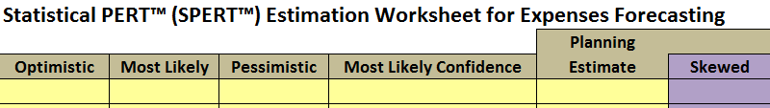
Use a Statistical PERT Free Template!
Statistical PERT Template for Expenses
Notes:
This is a snippet from a SPERT Expenses template. The yellow cells are intended to be user-entered.

Slide 59
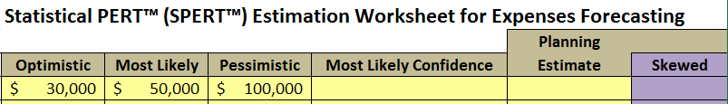
Use a Statistical PERT Free Template!
Statistical PERT Template for Expenses
Three-point
Estimate
Notes:
Self-explanatory. Enter a three-point estimate for an expense.

Slide 60
Use a Statistical PERT Free Template!
Statistical PERT Template for Expenses
Three-point
Estimate
Step 1
Notes:
Point out that this is Step 1 of a five-step process.

Slide 61
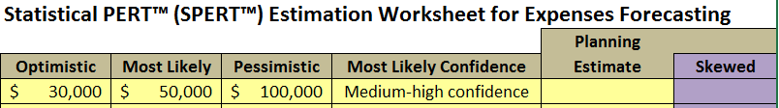
Use a Statistical PERT Free Template!
Statistical PERT Template for Expenses
Three-point
Estimate
Step 1
Subjective
Opinion
Notes:
Next step involves making a subjective opinion about the most likely outcome. If you were using a game spinner, which one would you choose?
For this example, we’re choosing Medium-High confidence in the most likely outcome.

Slide 62
Use a Statistical PERT Free Template!
Statistical PERT Template for Expenses
Three-point
Estimate
Step 1
Subjective
Opinion
Step 3
Notes:
That’s Step 3 of the five-step process. What happened to Step 2? It’s done for you by the spreadsheet formulas (use the PERT formula to estimate the mean).

Slide 63
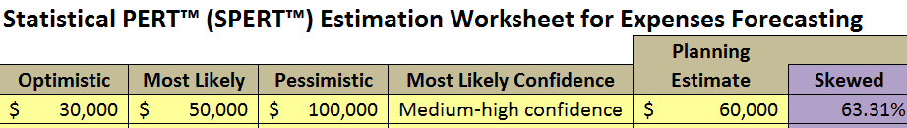
Use a Statistical PERT Free Template!
Statistical PERT Template for Expenses
Three-point
Estimate
Step 1
Subjective
Opinion
Step 3
Planning
Estimate
Notes:
Choose a planning estimate for your project. You think the expense will be $50,000. It could be as much as $100,000. You think about putting $60,000 into the project budget. What is the likelihood that that will be enough so the project budget isn’t at risk?

Slide 64
Use a Statistical PERT Free Template!
Statistical PERT Template for Expenses
Three-point
Estimate
Step 1
Subjective
Opinion
Step 3
Planning
Estimate
Step 5
Notes:
That’s Step 5 of the process. What happened to Step 4 (the SPERT SD)? The SPERT template calculated it for you.

Slide 65
Use a Statistical PERT Free Template!
Statistical PERT Template for Expenses
63% is the probability of the expense being equal to or less than $60,000
Notes:
Look at the probability that the $60,000 will not be exceeded. There is a 37% probability that the project budget will be exceeded! Yikes!

Slide 66
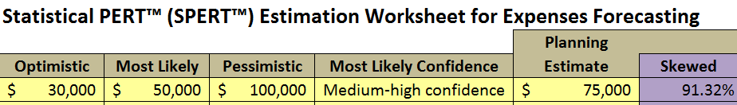
Use a Statistical PERT Free Template!
Statistical PERT Template for Expenses
91% is the probability of the expense being equal to or less than $75,000
…with Medium-High confidence
Notes:
Let’s change our cost planning estimate from $60,000 to $75,000. How did that change things? Now, there is a 91% cumulative probability that $75,000 will meet or exceed the actual cost of the expense.

Slide 67
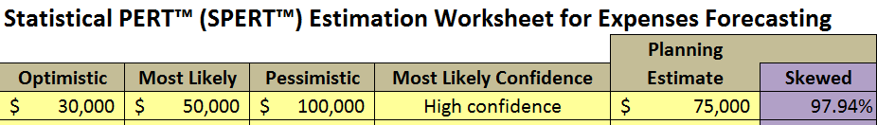
Use a Statistical PERT Free Template!
Statistical PERT Template for Expenses
98% is the probability of the expense being equal to or less than $75,000
…with High confidence
Notes:
What if we had subjective “high” confidence in the most likely outcome? How would that affect the cumulative probability?
We would be 98% confident that a $75,000 budget would meet or exceed the actual cost of the expense.

Slide 68
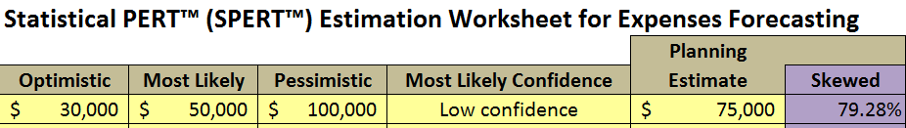
Use a Statistical PERT Free Template!
Statistical PERT Template for Expenses
79% is the probability of the expense being equal to or less than $75,000
…with Low confidence
Notes:
What if we only had “low” confidence in the most likely outcome?
The probability that $75,000 would be enough would decline to just 79%; there would be a 21% probability that the expense could be greater than $75,000.

Slide 69
The Five Easy Steps of Statistical PERT
Create a 3-point estimate
Estimate the mean
Render a subjective opinion
about the mode
Create a SPERT standard deviation
Choose a planning estimate
Notes:
Summary of the Five Steps of Statistical PERT.

Slide 70
The Five Easy Steps of Statistical PERT
Create a 3-point estimate
Estimate the mean
Render a subjective opinion
about the mode
Create a SPERT standard deviation
Choose a planning estimate
Notes:
A reminder that if you use a free SPERT Excel template, there are really only three steps to the process; the spreadsheet template calculates the mean and standard deviation.

Slide 71
Demo
Notes:
Time for a demo! The demo will involve going to www.statisticalpert.com, downloading an Excel example workbook, and interacting with it by involving the audience to help make various estimates for any bell-shaped uncertainty.

Slide 72
Why I Use
Notes:
My last couple of minutes. I want to hammer home why anyone would go through the bother of using Statistical PERT or why we use any estimation tool or technique.

Slide 73
Why I Use Statistical PERT
To align everyone’s expectations about project uncertainties
To make better,
more informed project decisions
Notes:
These are the two reasons “Why” the audience should consider using Statistical PERT: 1) quickly align others’ expectations about project uncertainties (especially with respect to estimation risk), and 2) make better, more informed business decisions that respect the uncertain nature of projects.

Slide 74
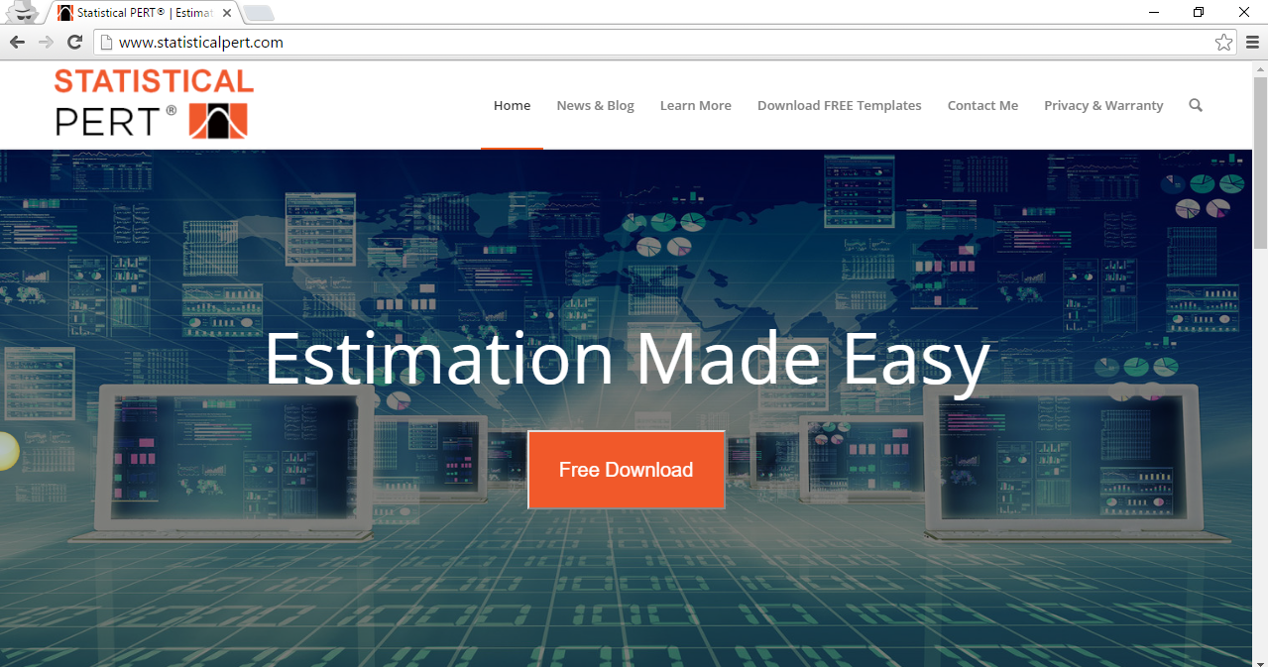
Download FREE Templates
www.StatisticalPERT.com
Notes:
I’ll leave this slide up for a minute so people can make note of the website.

Slide 75

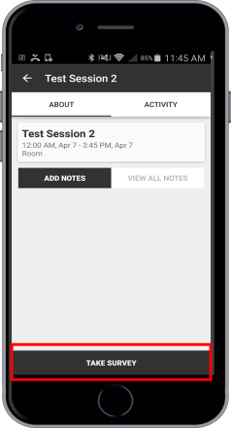


Thank you!
Please rate my session in the mobile app!
Name | William W. Davis, MSPM, PMP
Web | www.StatisticalPERT.com
Email | famousdavispmp@gmail.com
famousdavis
@famousdavis
famousdavis
Notes:
I’m done!!!!

